Slide 1
Word Lesson 5 Formatting Paragraphs and Documents
Microsoft Office 2010 Introductory
Pasewark & Pasewark

Slide 2
Objectives
Show and hide the ruler.
Set the margins of a document.
Align text and adjust paragraph indents.
Adjust line and paragraph spacing.
Change vertical alignment.
2
2

Slide 3
Objectives (continued)
Set and modify tab stops.
Create and modify bulleted, numbered, and outline numbered lists.
Organize a document in Outline view.
3
3

Slide 4
Vocabulary
alignment
bullet
center
first-line indent
hanging indent
indent
inside margin (gutter margin)
justify
leader
left-align
margin
mirrored margin
multilevel list
negative indent (outdent)
4
4

Slide 5
Vocabulary (continued)
outline numbered list
outside margin
right-align
tab stop (tab)
vertical alignment
5
5

Slide 6
Formatting Paragraphs and Documents
Formatting presents a consistent and attractive style throughout a document.
In this lesson, you will use the ruler, set margins, align paragraphs, and adjust paragraph indents and line spacing.
You will change the spacing before and after paragraphs, adjust tab stops, create lists, and use Outline view.
6
6

Slide 7
Viewing the Ruler
Word provides rulers along the top and left margins to help you as you format your documents.
The ruler is hidden by default.
To display it, you can click the View Ruler button located at the top of the vertical scroll bar on the right side of the window.
7
7

Slide 8
Setting Margins
Margins are the blank areas around the top, bottom, and sides of a page. Word sets predefined margin settings, which you can keep or change.
Book pages and magazines are often formatted with mirrored margins.
Inside margins (gutter margins) are closest to the inside of the page. Outside margins are closest to the edge of the page.
8
8

Slide 9
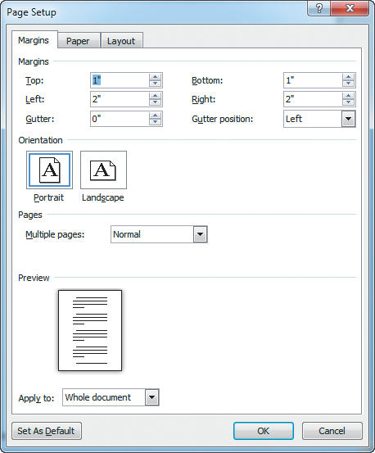
Setting Margins (continued)
Margins tab in the Page Setup dialog box
9
9

Slide 10
Aligning Text
Alignment refers to the position of text between the margins. You can left-align, center, right-align, or justify text.
Left-aligned and justified are the two most commonly used alignments in documents.
To align text, you click one of the Alignment buttons in the Paragraph group on the Home tab.
10
10

Slide 11
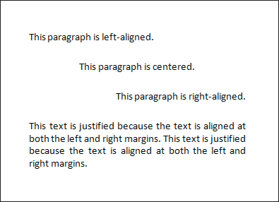
Aligning Text (continued)
Examples of different text alignments

Slide 12
Changing Indents
An indent is the space between text and a document's margin.
Indent from the left margin, right margin, or both margins.
Indent only the first line of a paragraph or all the lines in a paragraph except the first line.
To indent a paragraph one-half inch at a time, click the Increase Indent or Decrease Indent buttons on the Home tab.
12
12

Slide 13
Changing Indents (continued)
When using a first-line indent, only the first line of a paragraph is indented.
To indent the first line of a paragraph, you can drag the First Line Indent marker on the ruler.
After you set a first-line indent in one paragraph, all subsequent paragraphs you type will have the same first-line indent.
13
13

Slide 14
Changing Indents (continued)
You can create hanging indents in which the first full line of text is not indented but the following lines are.
Hanging indents appear commonly in lists and documents such as glossaries and bibliographies.
You can set indents on the Indents and Spacing tab in the Paragraph dialog box.
14
14

Slide 15
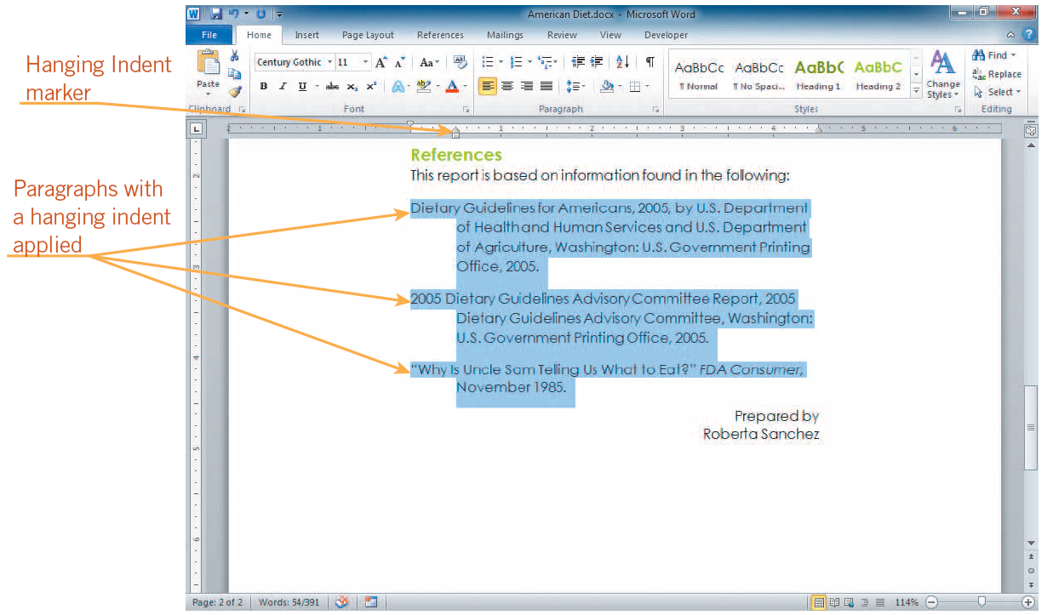
Changing Indents (continued)
Examining a handing indent

Slide 16
Adjusting Line Spacing
Line spacing is the amount of space between lines of text.
Single-spaced text has no extra space between each line; double-spaced text has an extra line of space between each line of text.
The default setting in a Word document is 1.15 lines, not single spaced.
16
16

Slide 17
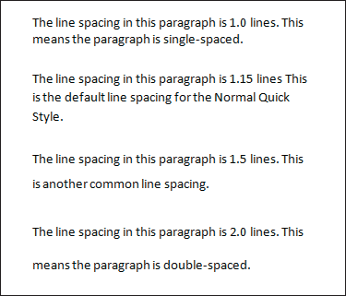
Adjusting Line Spacing (continued)
Different line spacing
17
17

Slide 18
Adjusting Paragraph Spacing
Paragraph spacing is the amount of space between paragraphs.
The default is to add 10 points of space after each paragraph.
Often heading styles include space before or after the heading paragraph as part of the style definition.
18
18

Slide 19
Changing Vertical Alignment
Vertical alignment refers to positioning text between the top and bottom margins of a document.
You can align text with the top of the page, center the text, distribute the text equally between the top and bottom margins (justify), or align the text with the bottom of the page.
19
19

Slide 20
Understanding Tab Stops
Tab stops, or tabs, mark the place where the insertion point will stop when you press Tab.
Tab stops are useful for creating tables or aligning numbered items.
In Word, default tab stops are set every half inch and are left-aligned.
Text alignment can be set with left, right, center, or decimal tab stops.
20
20

Slide 21
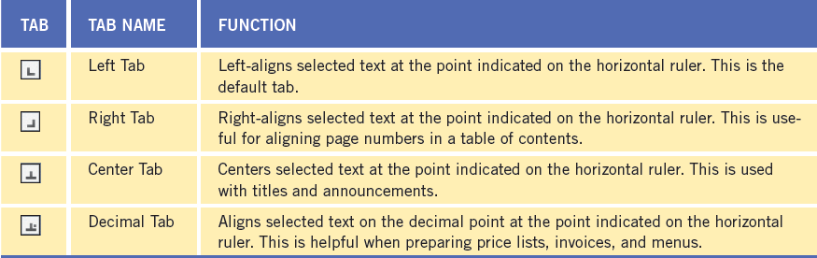
Understanding Tab Stops (continued)
Tab stops

Slide 22
Understanding Tab Stops (continued)
To set a tab stop, select the paragraph, and click the ruler at the desired tab location.
When you insert a tab stop, the default tab stops before that tab stop marker are erased.
To move a tab stop, drag the tab stop marker to a new location on the ruler.
To remove a tab, drag the marker off the ruler.
22
22

Slide 23
Understanding Tab Stops (continued)
Leaders are solid, dotted, or dashed lines that fill the blank space before a tab setting.
Leaders are often used in tables of contents.
To insert a leader, open the Tabs dialog box.
23
23

Slide 24
Using Bulleted and Numbered Lists
A numbered list is useful when items appear sequentially, such as instructions.
A bulleted list often is used when the order of items does not matter.
A bullet is any small character that appears before an item.
24
24

Slide 25
Using Bulleted and Numbered Lists (continued)
A way to create a numbered or bulleted list as you type is to create a paragraph, and then click the Numbering or Bullets button on the Home tab.
You can also change a list that you already typed to a bulleted or numbered list by selecting the items, and then clicking either the Bullets or Numbering button.
25
25

Slide 26
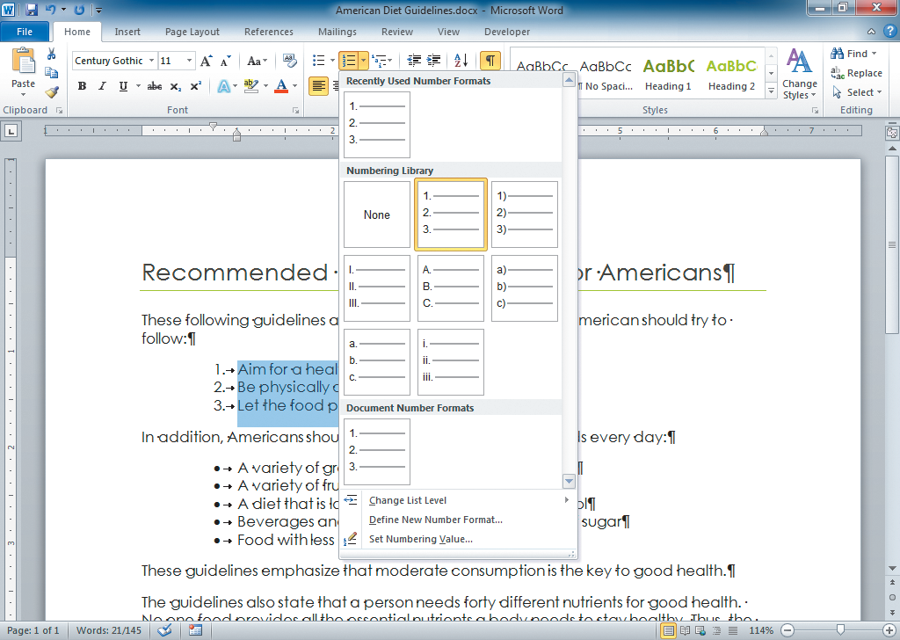
Using Bulleted and Numbered Lists (continued)
Numbering gallery

Slide 27
Using Bulleted and Numbered Lists (continued)
You can customize bulleted and numbered lists by changing the indents or customizing the bullets or numbers.
A multilevel list is a list with two or more levels of bullets or numbering. A numbered multilevel list is sometimes called an outline numbered list.
27
27

Slide 28
Organizing a Document in Outline View
In Outline view, you can type topic headings and subheadings for a document.
Word usually formats the first line with the Heading 1 style. Press Enter to create the heading. If you press the Tab key, you create a Level 2 heading.
Once you have typed an outline, you can easily modify it.
28
28

Slide 29
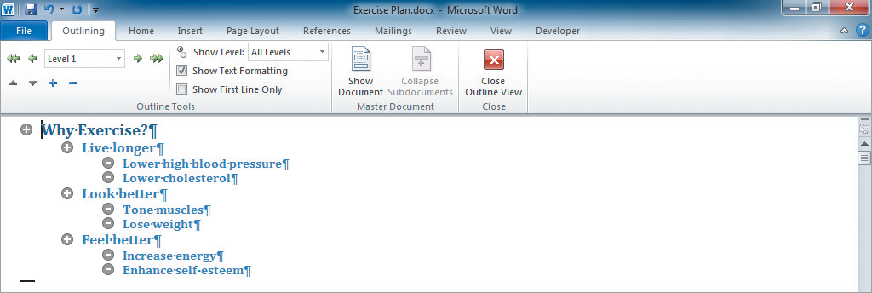
Organizing a Document in Outline View (continued)
Text in Outline view

Slide 30
Summary
In this lesson, you learned:
You can show and hide the ruler to suit your working style by clicking the View Ruler button at the top of the vertical scroll bar, or by clicking the View tab, and then selecting the Ruler check box in the Show/Hide group.
Margins are the blank areas around the top, bottom, and sides of a page. You can change the margin settings by clicking the Margins button in the Page Setup group on the Page Layout tab.
30
30

Slide 31
Summary (continued)
You can align text by clicking one of the alignment buttons in the Paragraph group on the Home tab.
You can indent text either from the left margin, from the right margin, or from both margins. You can also set first-line and hanging indents.
You can change the line spacing of text from the default of 1.15 lines to 1.0 (single-spaced), 2.0 (double-spaced), or greater. You can change the paragraph spacing by changing the measurements in the Before and After boxes in the Paragraph group on the Page Layout tab.
31
31

Slide 32
Summary (continued)
You can change the vertical alignment of text by opening the Page Setup dialog box, clicking the Layout tab, and selecting an alignment option from the Vertical alignment list in the Page section.
Text alignment can be set with left, right, centered, or decimal tabs. Leaders can be used with any kind of tab.
32
32

Slide 33
Summary (continued)
You can use the Bullets or Numbering buttons in the Paragraph group on the Home tab to create bulleted or numbered lists. To change the appearance of a list, click the arrow next to the Bullets or Numbering button to choose a different bullet or numbering style.
You can use the Multilevel list button in the Paragraph group on the Home tab to create a list with a hierarchical structure.
You can work in Outline view to set up the outline of a document.
33
33

